Slide 1


DEPARTMENT OF COMPUTER SCIENCE AND ENGINEERING
20CS7503 & DESIGN PROJECT – III
END SEMESTER PRACTICAL EXAMINATION- NOV / DEC 2025
REVIEW PRESENTATION
Batch No.:04
Date:29/11/2025
Session:

Slide 2
TITLE : TEXT EXTRACTION AND ENCHANCEMENT SYSTEM ARCHITECTURE WITH EASY OCR AND OPEN CV
Guide Name:
Mrs. VALLI PRIYADHARSHINI.K, M.E, (PhD),
AP/CSE, KRCT
Team Members:
SESHANTH.B [811722104137]
SHAM JOSEPHRAJ.W [811722104140]
YOGESH WARAN.T.K [811722104189]

Slide 3
OBJECTIVE OF THE PROJECT
1. To build a tool that can clean and improve images.
2. using OpenCV and extract text from them using EasyOCR.
3. Helps in reading text clearly making the text more accurate.

Slide 4
INTRODUCTION
1. To enhance images by removing noise.
2. adjusting brightness/contrast.
3. sharpening edges before text recognition.
4. To extract the text accurately.
5. creating a system useful for document scanning, digital archives, data collection, and accessibility.

Slide 5
LITERATURE SURVEY
TITLE OF PAPER | AUTHOR(S) | YEAR OF PUBLISH | TECHNOLOGY USED PRO’S & CORN’S
Mobile-Based OCR for Indian Scripts (Survey) | Survey (Multiple Indian Researchers | 2024 | Neural Networks, OCR Modules, Translation & TTS (Voice Output) PROS: Inclusive,accessible. CORNS: Outdated,inaccurate.
Real-Time Text Detection and Recognition from Video and Webcam | B. Avinash, Ishrath Anjum Shaik, Roohi Syed | Apr, 2024 | OpenCV EAST Text Detector, Tesseract OCR. PROS : Fast,Practical. CORNS: Noisy,sensitive.
Efficient Text Extraction and Summarization using EasyOCR and GPT-3 | Dr. A. V. Sriharsha, Mekala Bhavana, Syamala Tejaswee, Mynasaheb Bushra, | 2019 | EasyOCR for text extraction, GPT-3 for summarization PROS : Accurate,Contextual. CORNS : Costly,Heavy,Limited

Slide 6
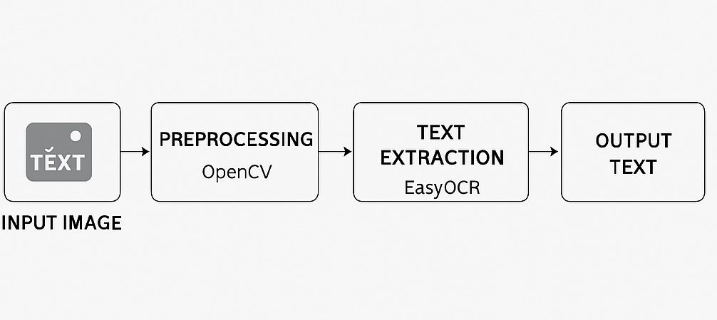
EXISTING SYSTEM ARCHITECTURE

Slide 7
PROBLEM IDENTIFICAITON
1. Low-Quality Images Affect Text Recognition
2. Limited Language and Script Support
3. Inaccurate Extraction from Complex Layouts
4. Hardware Dependency
5. Privacy and Security Concerns

Slide 8
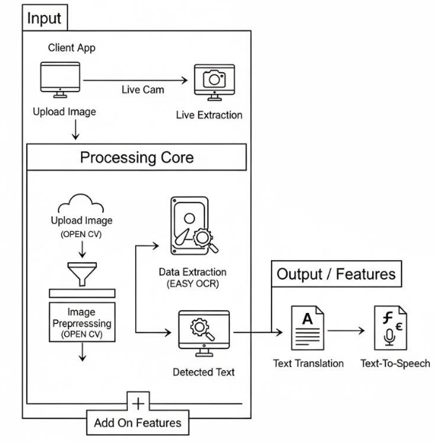
PROPOSED SYSTEM ARCHITECTURE

Slide 9
SOFTWARE AND HARDWARE REQUIREMENTS
HARDWARE
1. GPU: NVIDIA RTX 3050 series or higher with 8GB VRAM or more
2. CPU: Intel i7/i9 or AMD Ryzen 7 or more with atleast 8 cores
3. RAM : 16GB or more
Storage : 1TB SSD
SOFTWARE
1. Programming Language: Python 3.7
2. Libraries:
Deep Learning : TensorFlow
NLP
EASYOCR
GTTS
Googletrans
3. Operating System : Linux or Windows

Slide 10
MODULES
1. User Interface
2. Data Preprocessing Module
3. Text Detection and Extraction Module
4. Translation Module
5. Text-to-Speech Synthesis Module

Slide 11
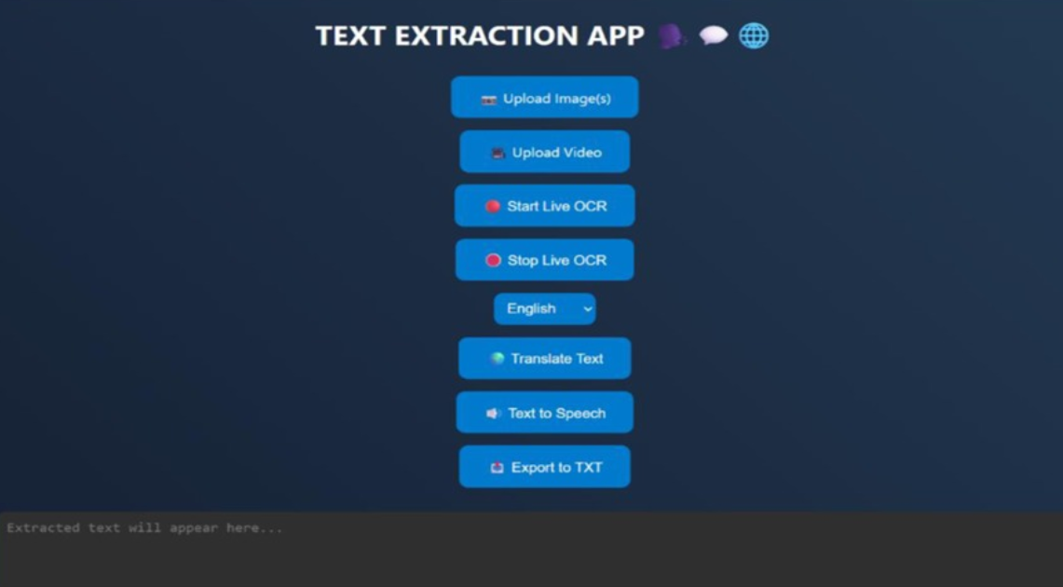
IMPLEMENTATION OF MODULE-1
1. Shows options for the user to upload an image and select what they want to do.
2. Displays the results clearly on the screen after processing.

Slide 12
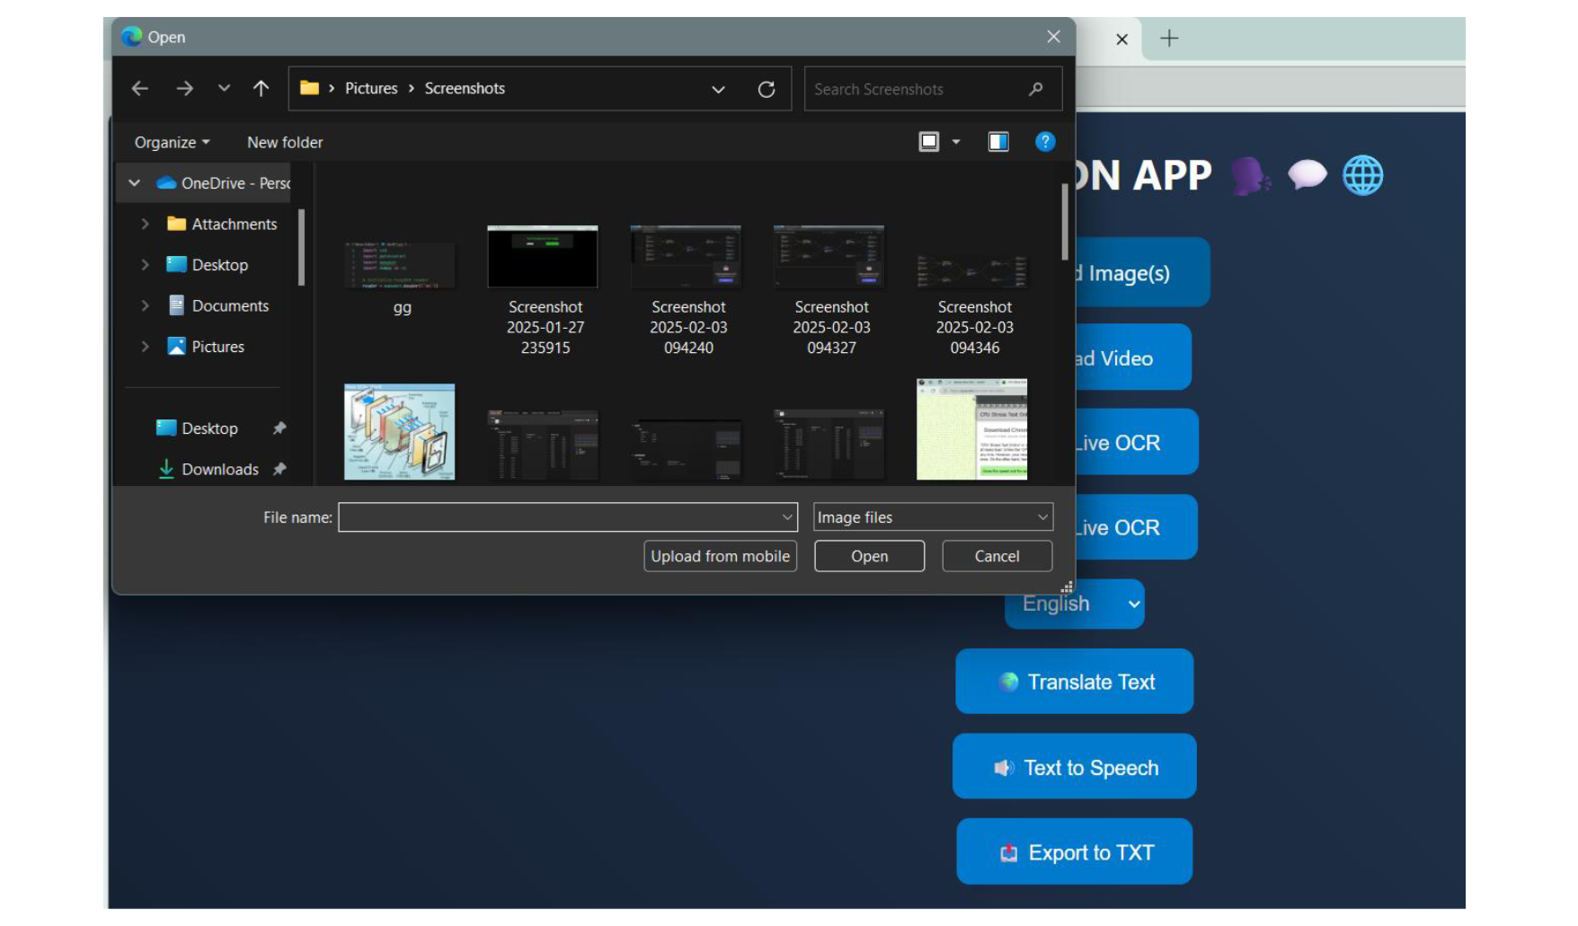
IMPLEMENTATION OF MODULE-2

Slide 13
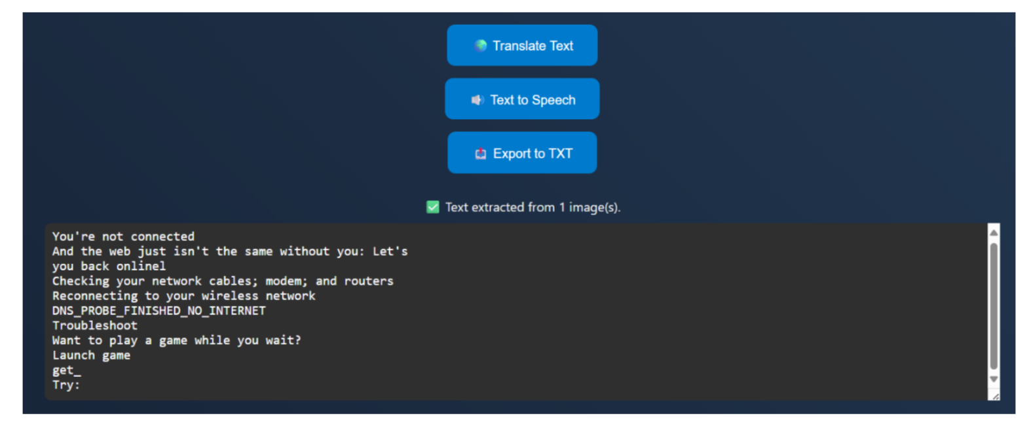
IMPLEMENTATION OF MODULE-3

Slide 14
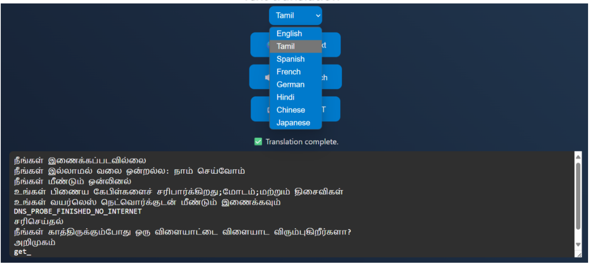
IMPLEMENTATION OF MODULE-4

Slide 15
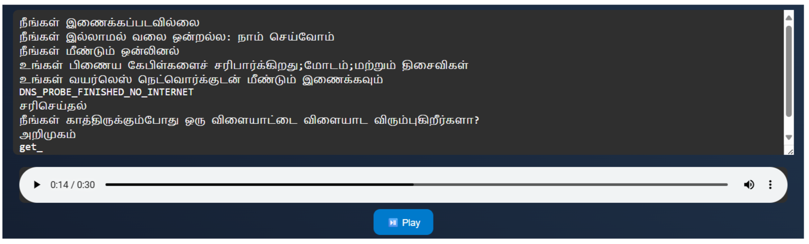
IMPLEMENTATION OF MODULE-5

Slide 16
CONCLUSION
1. In conclusion, Text Detection and Extraction using Deep Learning Techniques with integrated features like Translation and Text-to-Speech offers a powerful solution for extracting and processing text from images or documents.
2. This enhanced system improves accessibility, enables multilingual support, and provides seamless audio output, ensuring greater user convenience and engagement.

Slide 17
FUTURE ENHANCEMENTS
1. Multilingual Support Expansion:Integrate additional language packs and advanced translation models to support a wider range of scripts and dialects, making the system more globally accessible
2. Cloud-Based Deployment :Move the system to a cloud platform to allow scalable, remote access and collaborative use, reducing hardware dependency for end-users.

